Slide 1
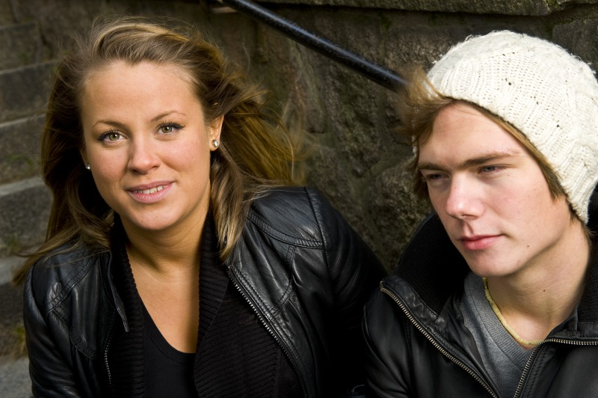
FILUR Intensified action for unemployed youth

Slide 2
FILUR
Partners
The project runs from 2010 -2013
Co funded by the European socialfund and
City of Stockholm / Labourmarket department.
Budget: 1700 000 Euro
The Swedish public employment service
The Swedish social insurace
City of Sundbyberg, labourmarket administration
14 city council districts

Slide 3
Main Project goals
Reduce the proportion of long-term unemployed young people
Give intensified support to young people who find it most
difficult to establish themselves in the labor market.
Identifiy defects that exist in the systems that handle
young people.
500 participants in three years
(400 comlete the whole program)
3 parallell groups with 15 youths each
15 new participants every months

Slide 4
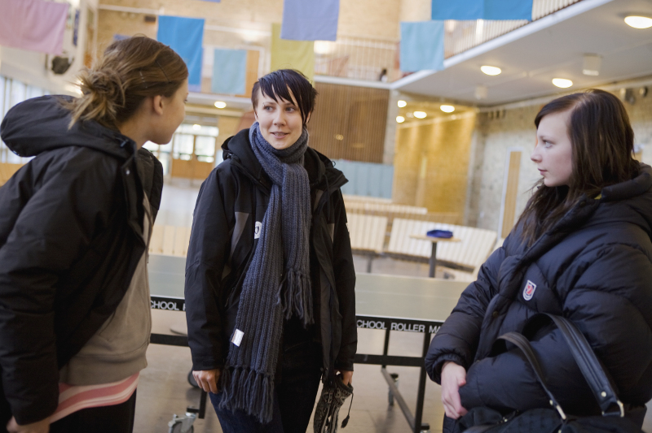
Target group
Long term unemployed (6 months)
16-24 years old
Youths from Jobbtorg/project partners that need
extra support
Who recieves social welfare benefits
Need intensified support and help
Youth with special needs:
School dropouts
Neuropsychiatric diagnosis
Mental illness
Former drugabuse
Economic problems / economic dept

Slide 5
The ”7-tjugo” method
Linked efforts during three moths
Week 1 | Week 2 | Week 3 | Week 4 | Week 5 | Week 6 | Week 7 | Week 8
Trainee position 4 weeks
Mentorship 1 year (optional)
8-15 participants per group
Monday – Friday 09:15-12:00
Breakfast
Self-reinforcing education program
Linked exercises Self esteem, communication, my recources, long/short term goals
Group program with daily meetings individual support
Trainee position
Study visits and interaction with the business sector through mentors

Slide 6
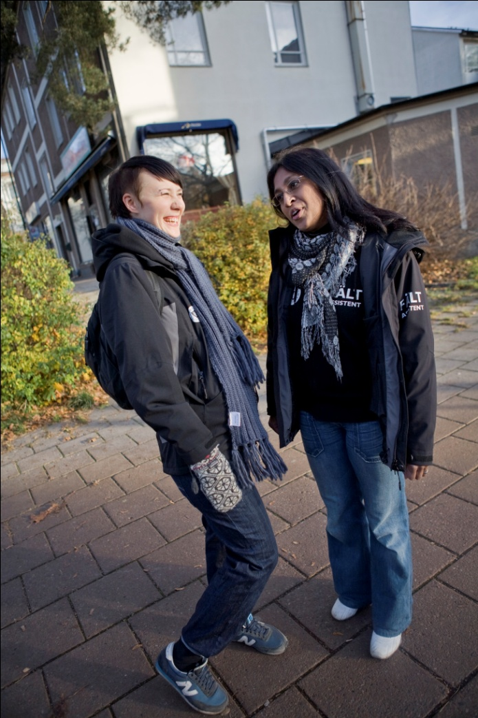
Project goals and results so far
Project goals:
50 % self sufficient 6 months after
finishing the program.
Results:
Evaluation after 6 months made of all who completed
the program:
Dec 2011
211 persons completed the programme (Group 1-15)
75 % is self sufficient through employment or studies.

Slide 7
Success factors
Structured method, daily meetings in group and with individual support.
Positive reinforcment
Build Selfconfidence
Safety within the group
Become ”The driver” of there lives
Dedicated staff

Slide 8
Thanks for listening!
Helen Starkman (project manager)
Helen.starkman@stockholm.se
+46 76 12 35 602
Isyan Tamburaci (coach)
Isyan.tamburaci@stockholm.se
+46 76 12 35 611

